Slide 1
The Enlisted Association Chapter 39
15821 E Centretech Cir
Aurora Co 80011
15821 E Centretech Cir
Aurora CO 80011
303-340-3939
January, February, & March 2023

Slide 2
A WORD FROM THE PRESIDENT
THINGS TO DO AT CHAPTER 39
SEE CALENDARS FOR DETAILS
On November 16th we had our yearly elections for the Board of Directors for the new year. It is always an exciting time of the year. On December 3rd, the installation of the new board members of TREA Chapter 39 and the Auxiliary took place. The President of TREA National, Deborah Oelschig, swore in both boards, after which we had a wonderful dinner catered by Olive Garden. The entertainment was provided by Highway 83. Later that evening we had a fun gift exchange.
2023 will be a challenging year, but we are confident that a lot of good will be done to promote and assist its members, their families and future generations. Especially promoting and supporting the education of service personnel, remembering that the welfare of our members and the enlisted community comes first.
We can only accomplish these goals with the help and support of our members. It is our members that make TREA Chapter 39 successful. Fortunately, we have some of the best members that have made our goals successful, and I am confident that you will continue to do so.
United We Stand
Mary Clarvoe, President
TREA Chapter 39
Bison Burger Dinner July 16th
October 1st 5:30-7pm
A WORD FROM THE AUXILIARY
What a great year we had. Thank you everyone who helped us get through 2022. I want to wish everyone who took office for 2023 Congratulations, Good Luck, and Thank You.
We want to congratulate the winners for the raffle baskets: Sam Lovell & Bob Corson. We hope everyone comes to our dinners in 2023. Patty Arcuri will be doing the cooking. We had to let Barbara Tackitt have a break, she has worked so hard for TREA. Dinners will be the 3rd Saturday of the month starting with January 21st at 5:00. I want to wish everyone a happy New Year and we want to make TREA 39 Stronger.
United We Stand
Helen Suggs
"If at first you don't succeed, try, try again. Then quit. No use being a damn fool about it." ―W.C. Fields
Queen of Hearts drawing every Saturday at 7:00pm.

Slide 3
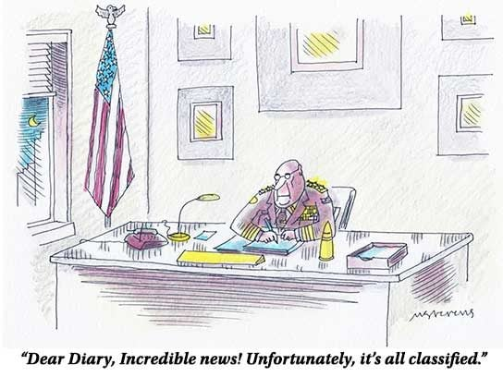
MANAGER’S MINUTE
CHAPLAIN’S CORNER
After the passing of Father John, we include article he wrote for the beginning of 2022:
As we approach the end of a very difficult year, we need to take stock. We have made a lot of new friends this year. We have gained several new club members, that’s a plus. If you see them, take the time to go over and introduce yourself. They are the lifeblood of our club.
Unfortunately, we also lost several of our brothers, which reminds us all we never know when we will be called. That’s why it behooves all of us to keep our affairs in order. Think of your family and make a will, they are not that expensive.
On a lighter note, we elected a new Board of Directors. So, we will go into the New Year with some new ideas. If anyone on the Board asks for your help, please try to help.
Our toy drive was a success once again this year. Thank you to all who donated.
Christine Johnson, our new Treasurer, did a great job last year with our charities. We raised more that we have in several years. TREA 39 is looking for someone else to take over the task of soliciting, monitoring, and tracking our charitable donations. Please contact CJ if you are interested.
On a personal note, it has been a satisfying year for me, I feel I am blessed with many friends and new relationships. Let’s look forward to a good year at TREA 39 and please come out and support your club
Father John Green
Greetings,
Well friends, we made it through another year. 2022 was hard for many of us so it is good to put it behind us. And as we head into 2023, I hope you’ll come see us. It has been great to see so many folks returning, but we’re still missing some friends. Come in, have a drink, and catch up with old (and new) friends!
We’re been busy planning out the year, trying to make sure there is a variety of things happening each month. Want something you don’t see? Please reach out to myself or a committee member and let us know.
And as always, this is your Club, let me know what you’d like to see!
Charlie Keith
Club Manager
CHARITY REPORT
Our 2022 goal of $1,500 was met and surpassed!
Distribution of funds have already been made to the following charities: COMITIS Crisis Center/Veterans Community Living Center/Honor Bell/TREA Gives Program/Freedom Service Dogs/Wreaths Across America.
Stay tuned as we will be determining fund raising goals and the charities we as a chapter will be supporting in 2023! Your participation and contributions go a long way in helping those selected charities!
MEMBERSHIP REPORT
Hello Everyone!
Please make sure to update your information with TREA National for Chapter members and TREA Chapter 39 for club members. Having an email address on file is the best way for us to get information out to you.
If you’re a “Club” member and haven’t been to the Club in a while, we are OPEN for business! If you would like to renew your membership, come in and fill out a new form. Membership is $30 a year (additional $5 for a door key card). We have some exciting events in coming up.
If you are on Facebook, go to our FB page and Follow/Like: TREA Chapter 39
You can also go to our website to check out the monthly calendar and new hours of operation: http://www.treach39.qwestoffice.net
May all your troubles last as long as your New Year’s resolutions. ~Joey Adams

Slide 5
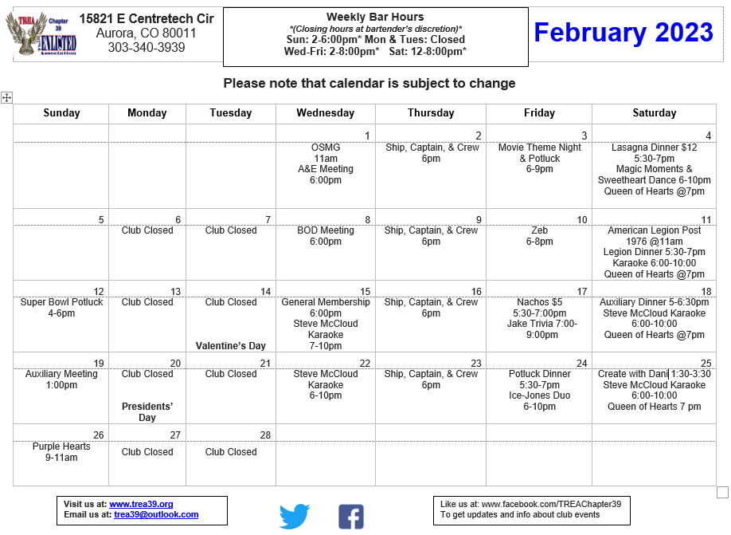

Slide 6
Spring cleaning never killed anyone, but why take the chance?

